Slide 1
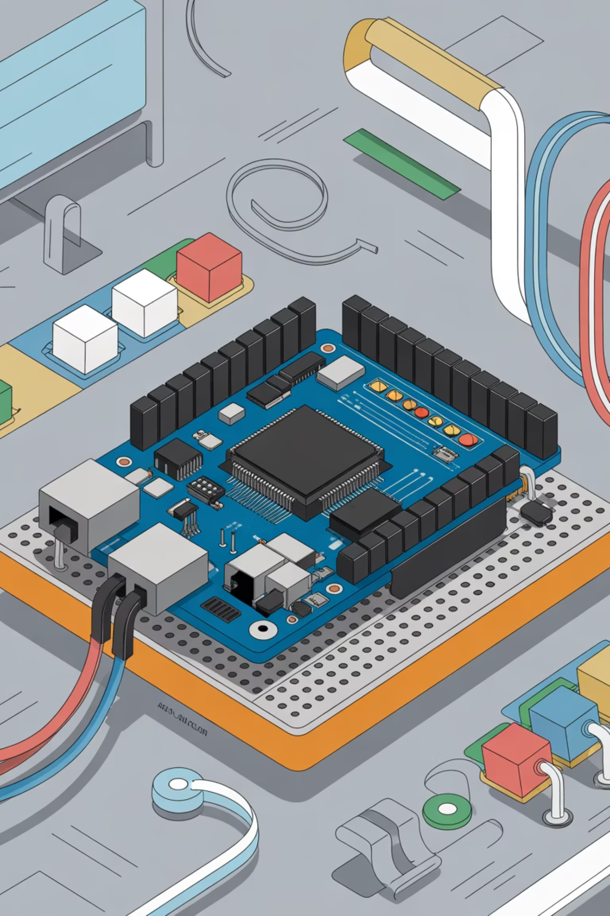

Wire We Doing This?
Building IoT Systems from Scratch
F-Con 2025

Slide 2
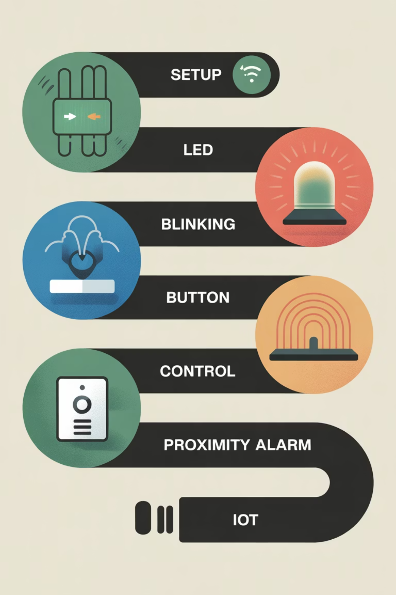
Today's Journey
What We're Building:
Phase 0: Power test & connectivity (Setup)
Phase 1: Blink an LED (Crawl)
Phase 2: Button control with feedback (Walk)
Phase 3: Distance-sensing proximity alarm (Run)
The Goal: Understand how sensors, processors, and outputs work together to create IoT systems

Slide 3

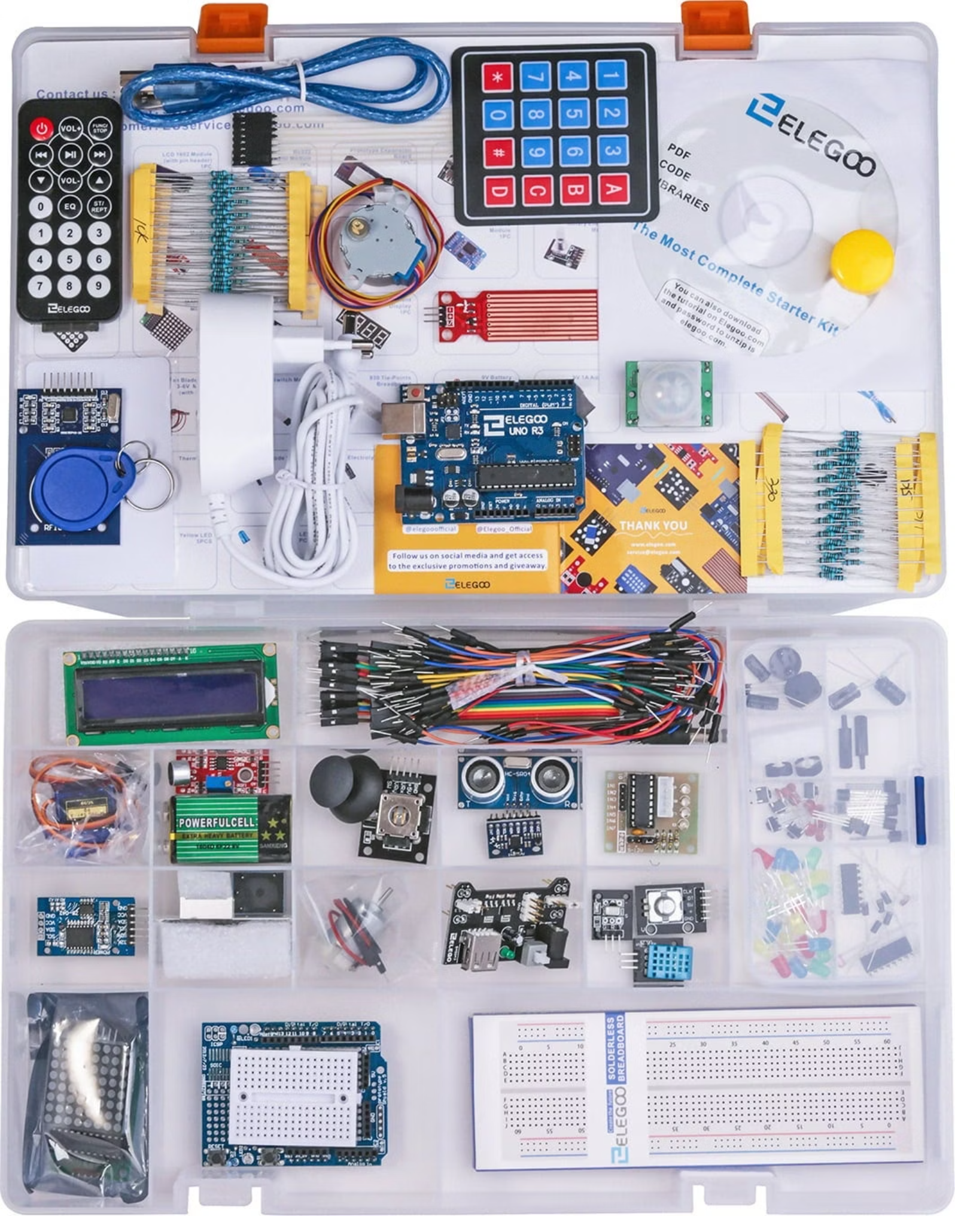
What's In Your Kit?
Key Components We're Using Today:
Arduino Uno - Your programmable brain
HC-SR04 Ultrasonic Sensor - Distance measurement
Breadboard & Prototype Shield - Your workspace
4-Digit 7-Segment Display - Numerical readout
Power Supply Module - Clean 5V power distribution
74HC595 Shift Register - Efficient display control
Green LED - Visual output
Supporting cast: 220Ω resistors, jumper wires
Active Buzzer - Audio alerts
Push Button - User input

Slide 4
Arduino 101
What is Arduino?
Why Arduino?
A microcontroller board that:
Easy to learn
Reads inputs (buttons, sensors, signals)
Massive community support
Processes information (runs your code)
Powers everything from hobby projects to commercial products
Controls outputs (lights, displays, buzzers)

Slide 5



The IoT Building Block Concept
SENSOR
PROCESSOR
OUTPUT
Gather information (distance, temperature, motion)
Make decisions (Arduino analyzes the data)
Take action (displays, buzzers, lights)
Every IoT device follows this pattern. Today you'll build increasingly complex systems using this exact pattern.

Slide 6

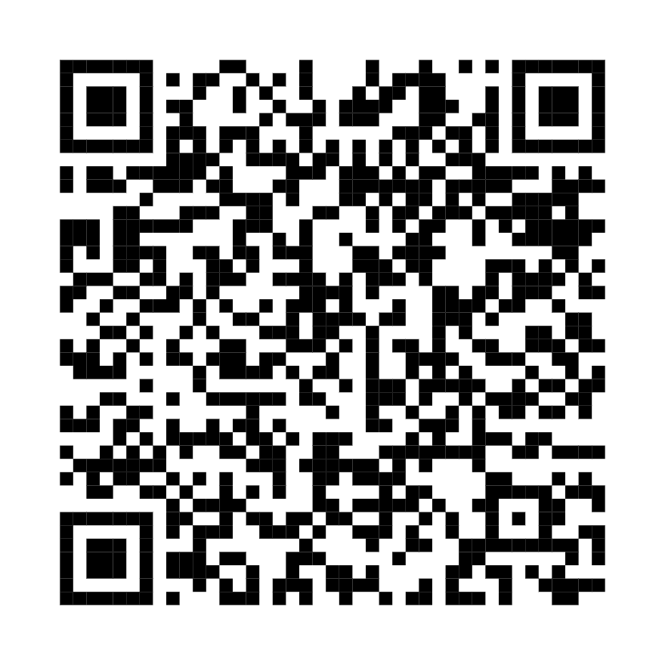

Setup Check
Before We Start:
Kit contents verified
Arduino IDE installed and open
Arduino connected via USB
GitHub repository link ready
GitHub Resources: https://tinyurl.com/5fan5erw All code, wiring diagrams, and troubleshooting guides
https://github.com/Fulcrum-Technology-Solutions/fcon_2025_iotoys

Slide 7
Phase 0 - Power Test (Setup)
Goal:
Verify everything is connected and powered correctly
Why This Matters:
What You're Learning:
A solid power foundation prevents 90% of problems!
Breadboard power distribution
Arduino connectivity
Serial communication basics

Slide 8

Phase 0 - Let's Build
Steps:
01
02
Connect power supply module to breadboard rails
Connect Arduino 5V to breadboard top rail
03
04
Connect Arduino GND to breadboard ground rail
Copy Phase 0 code from GitHub
05
06
Upload and open Serial Monitor (9600 baud)
Verify "System Status: READY" messages
Success: You should see power verification messages every 2 seconds

Slide 9

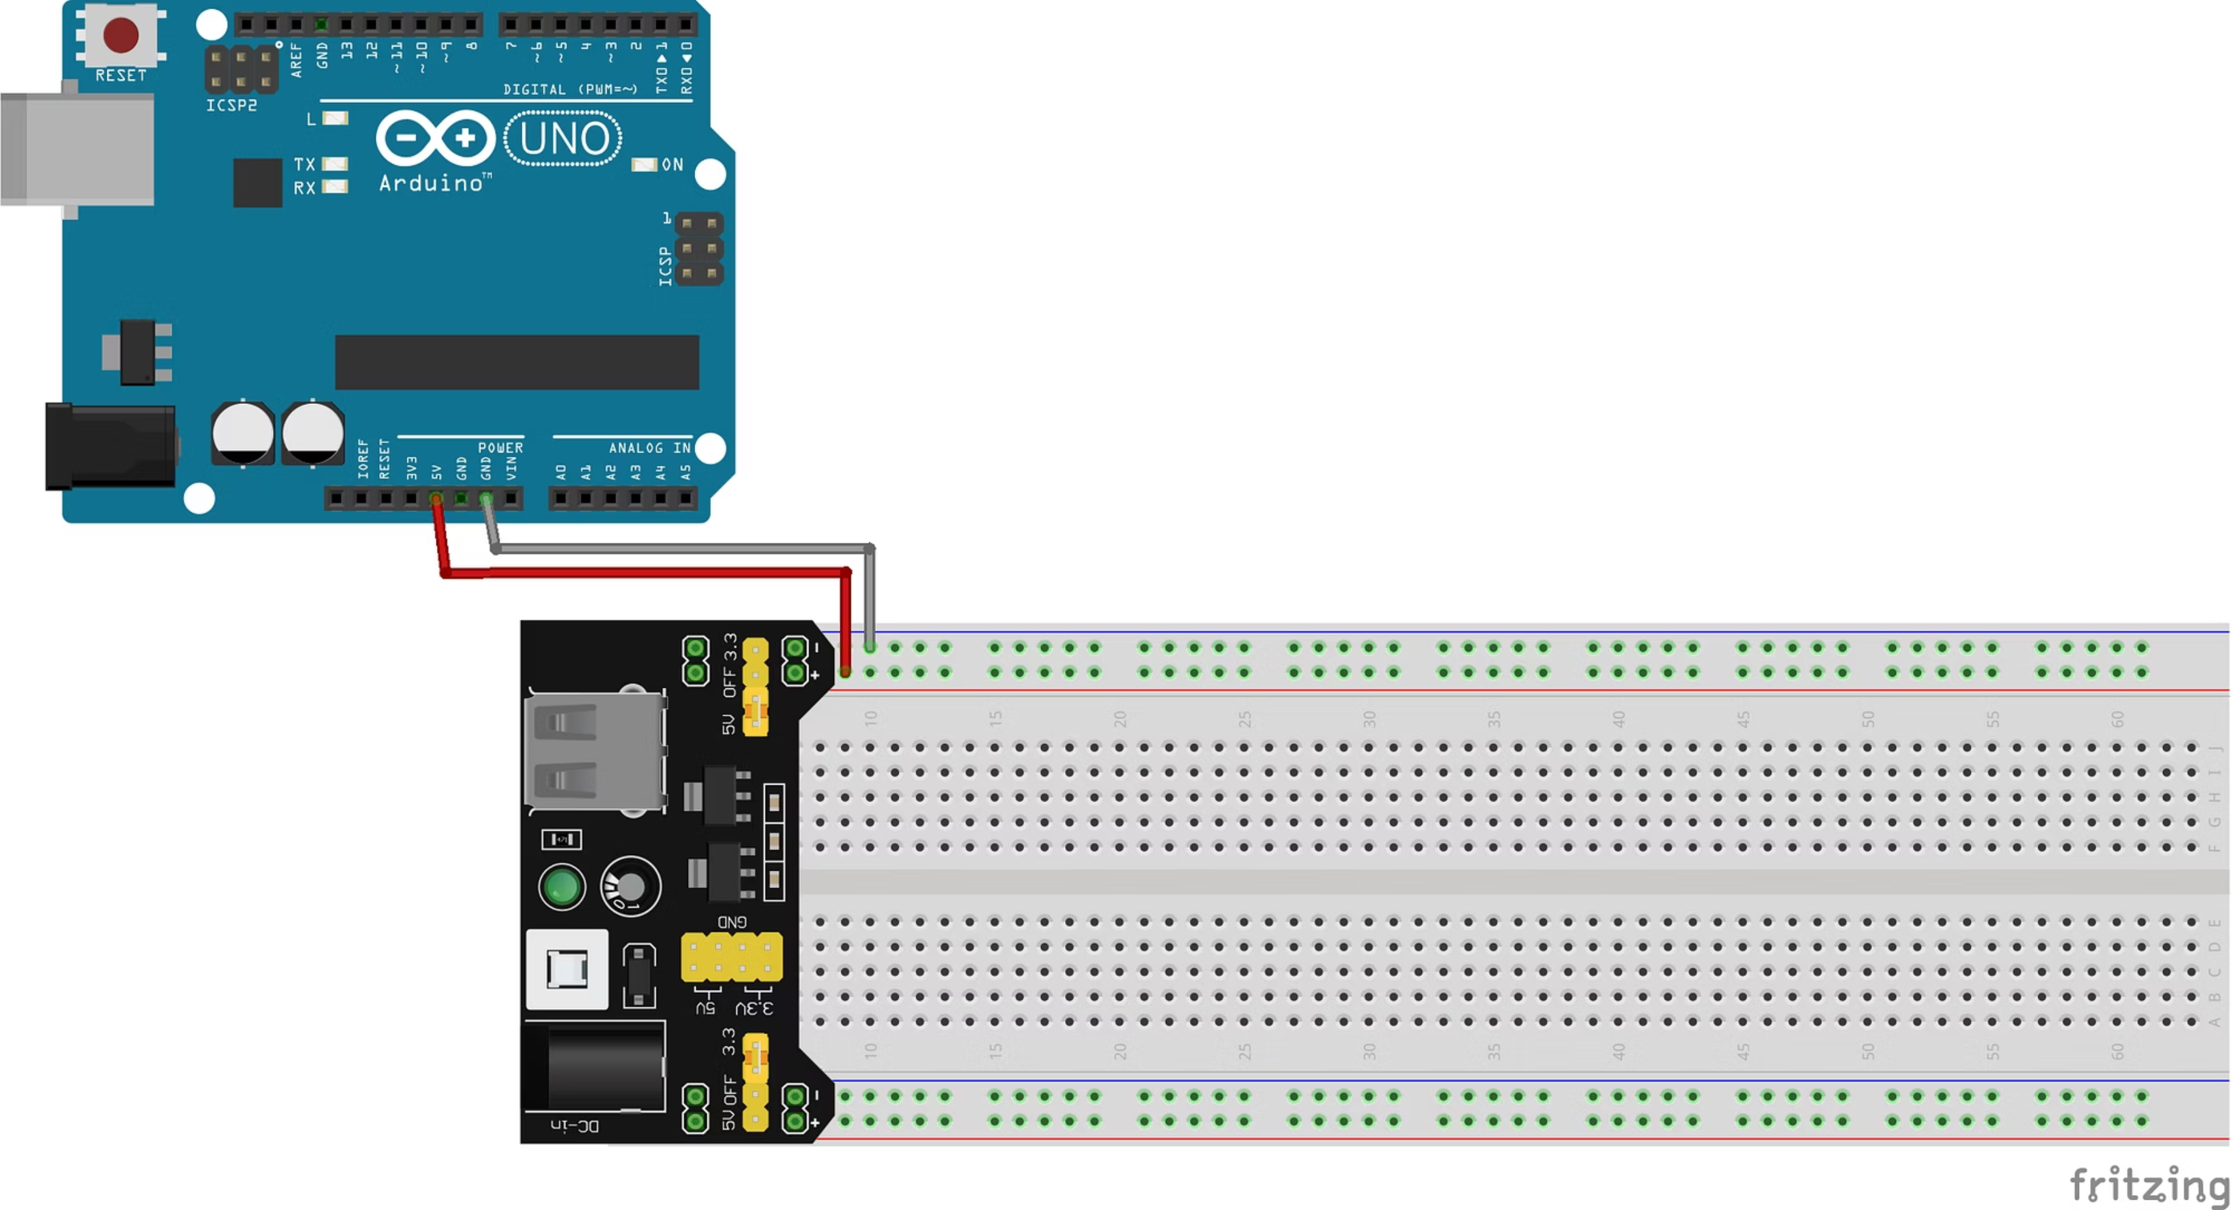

Slide 10
Phase 1 - First Light (Crawl)
Goal:
Real-World Applications:
Make an LED blink
Smart home lighting
Notification systems
What You're Learning:
Status indicators
Basic circuit building
Digital pin control (Pin 13)
Non-blocking timing with millis()

Slide 11
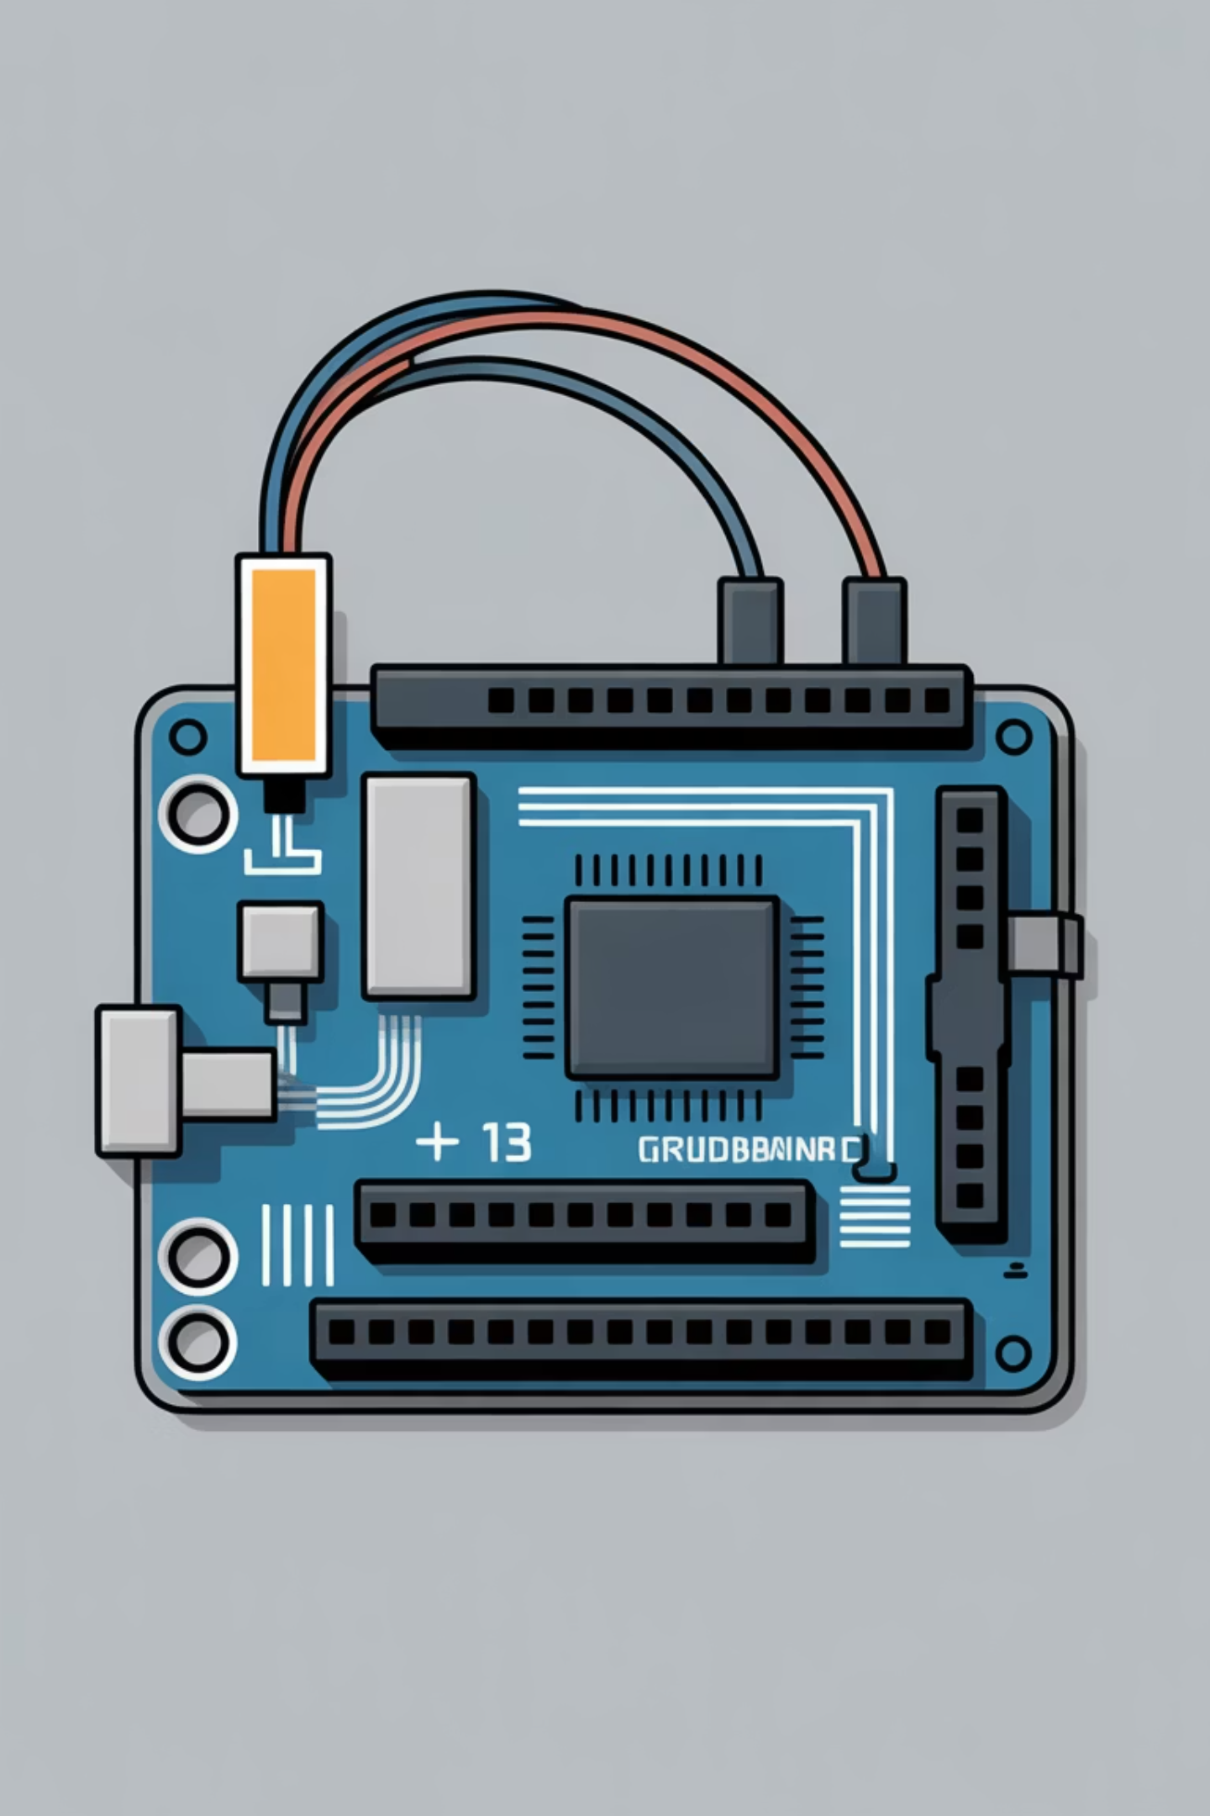
Phase 1 - Components
What You Need:
The Circuit:
1x Red LED
Pin 13 → LED positive (long leg)
Jumper wires
LED negative → Ground rail (direct connection, no resistor needed)
Breadboard (already powered from Phase 0)

Slide 12
Phase 1 - Let's Build
Steps:
01
02
Insert LED into breadboard
Connect Pin 13 to LED positive lead
03
04
Connect LED negative to ground rail
Copy Phase 1 code from GitHub
05
06
Upload to Arduino
Watch it blink! (500ms on, 500ms off)
Serial Monitor: Shows LED state changes with timestamps

Slide 13
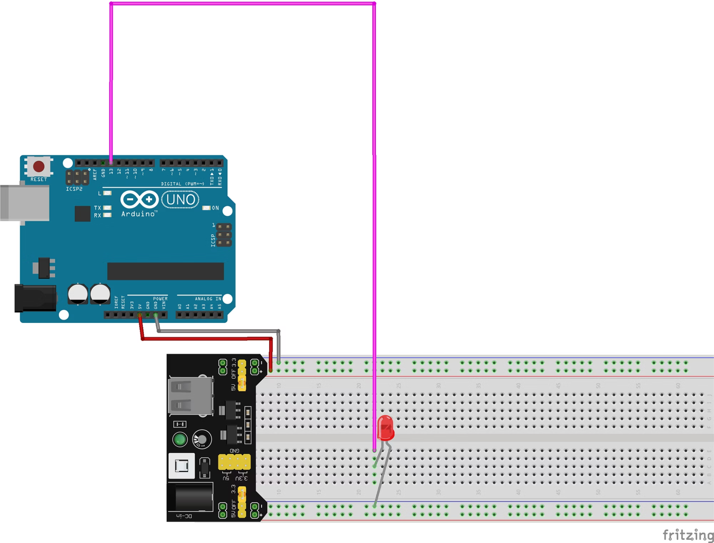
What You Need:
1x Red LED
Jumper wires
Breadboard (already powered from Phase 0)
The Circuit:
Pin 13 → LED positive (long leg)
LED negative → Ground rail (direct connection, no resistor needed)

Slide 14
Phase 2 - Button Control (Walk)
Goal:
Real-World Applications:
Button toggles LED on/off with buzzer feedback
Light switches
Alarm systems with user control
What You're Learning:
Interactive devices
Reading digital inputs (buttons)
INPUT_PULLUP resistor configuration
Controlling multiple outputs
State management

Slide 15

Phase 2 - Components
What You Need:
New Connections:
Red LED (from Phase 1 - keep it connected!)
Pin 7 → Buzzer positive
1x Push Button
Buzzer negative → Ground
1x Active Buzzer
Pin 8 → Button terminal
Jumper wires
Button other terminal → Ground

Slide 16
Phase 2 - Let's Build
Steps:
01
02
03
Keep Phase 1 LED connected
Add button between Pin 8 and ground
Add buzzer between Pin 7 and ground
04
05
Copy Phase 2 code from GitHub
Upload and test!
Expected Behavior:
Press button → LED toggles + buzzer beeps
Press again → LED toggles opposite way + beep

Slide 17
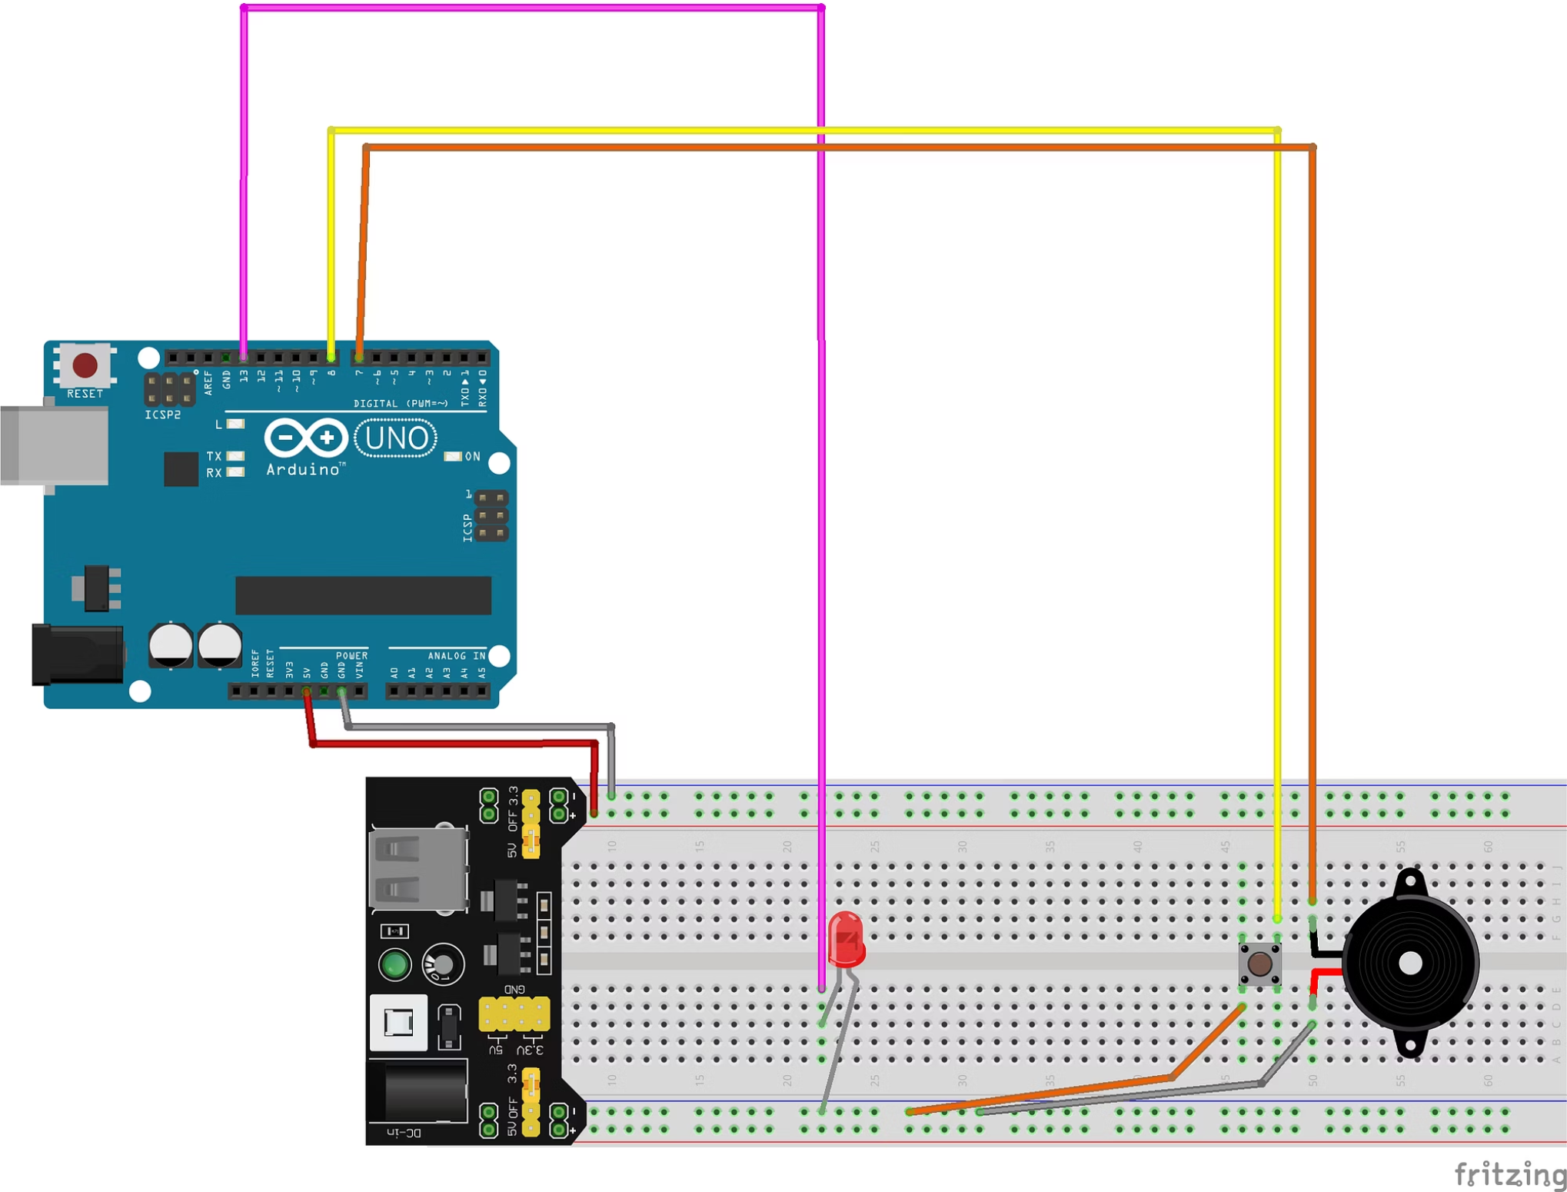
What You Need:
Green LED (from Phase 1 - keep it connected!)
1x Push Button
1x Active Buzzer
Jumper wires
New Connections:
Pin 7 → Buzzer positive
Buzzer negative → Ground
Pin 8 → Button terminal
Button other terminal → Ground

Slide 18
Phase 3 - Proximity Alarm (Run)
Goal:
Real-World Applications:
Distance-sensing alarm system that beeps faster as objects approach
Car parking sensors (backup alarms)
Security/intrusion detection
Automated door systems
What You're Learning:
Ultrasonic distance measurement
Shift register control for displays
Display multiplexing
Variable alarm behavior based on sensor input
Complete system integration

Slide 19
Phase 3 - The Complete System
This is a FULL IoT system with:
Input:
Processing:
Outputs:
Ultrasonic sensor measures distance (2-400cm)
Arduino calculates beep rate based on distance
4-digit display shows distance in cm
LED lights at ≤5cm
Buzzer beeps at ≤10cm (faster as distance decreases)
Mute button for buzzer control

Slide 20
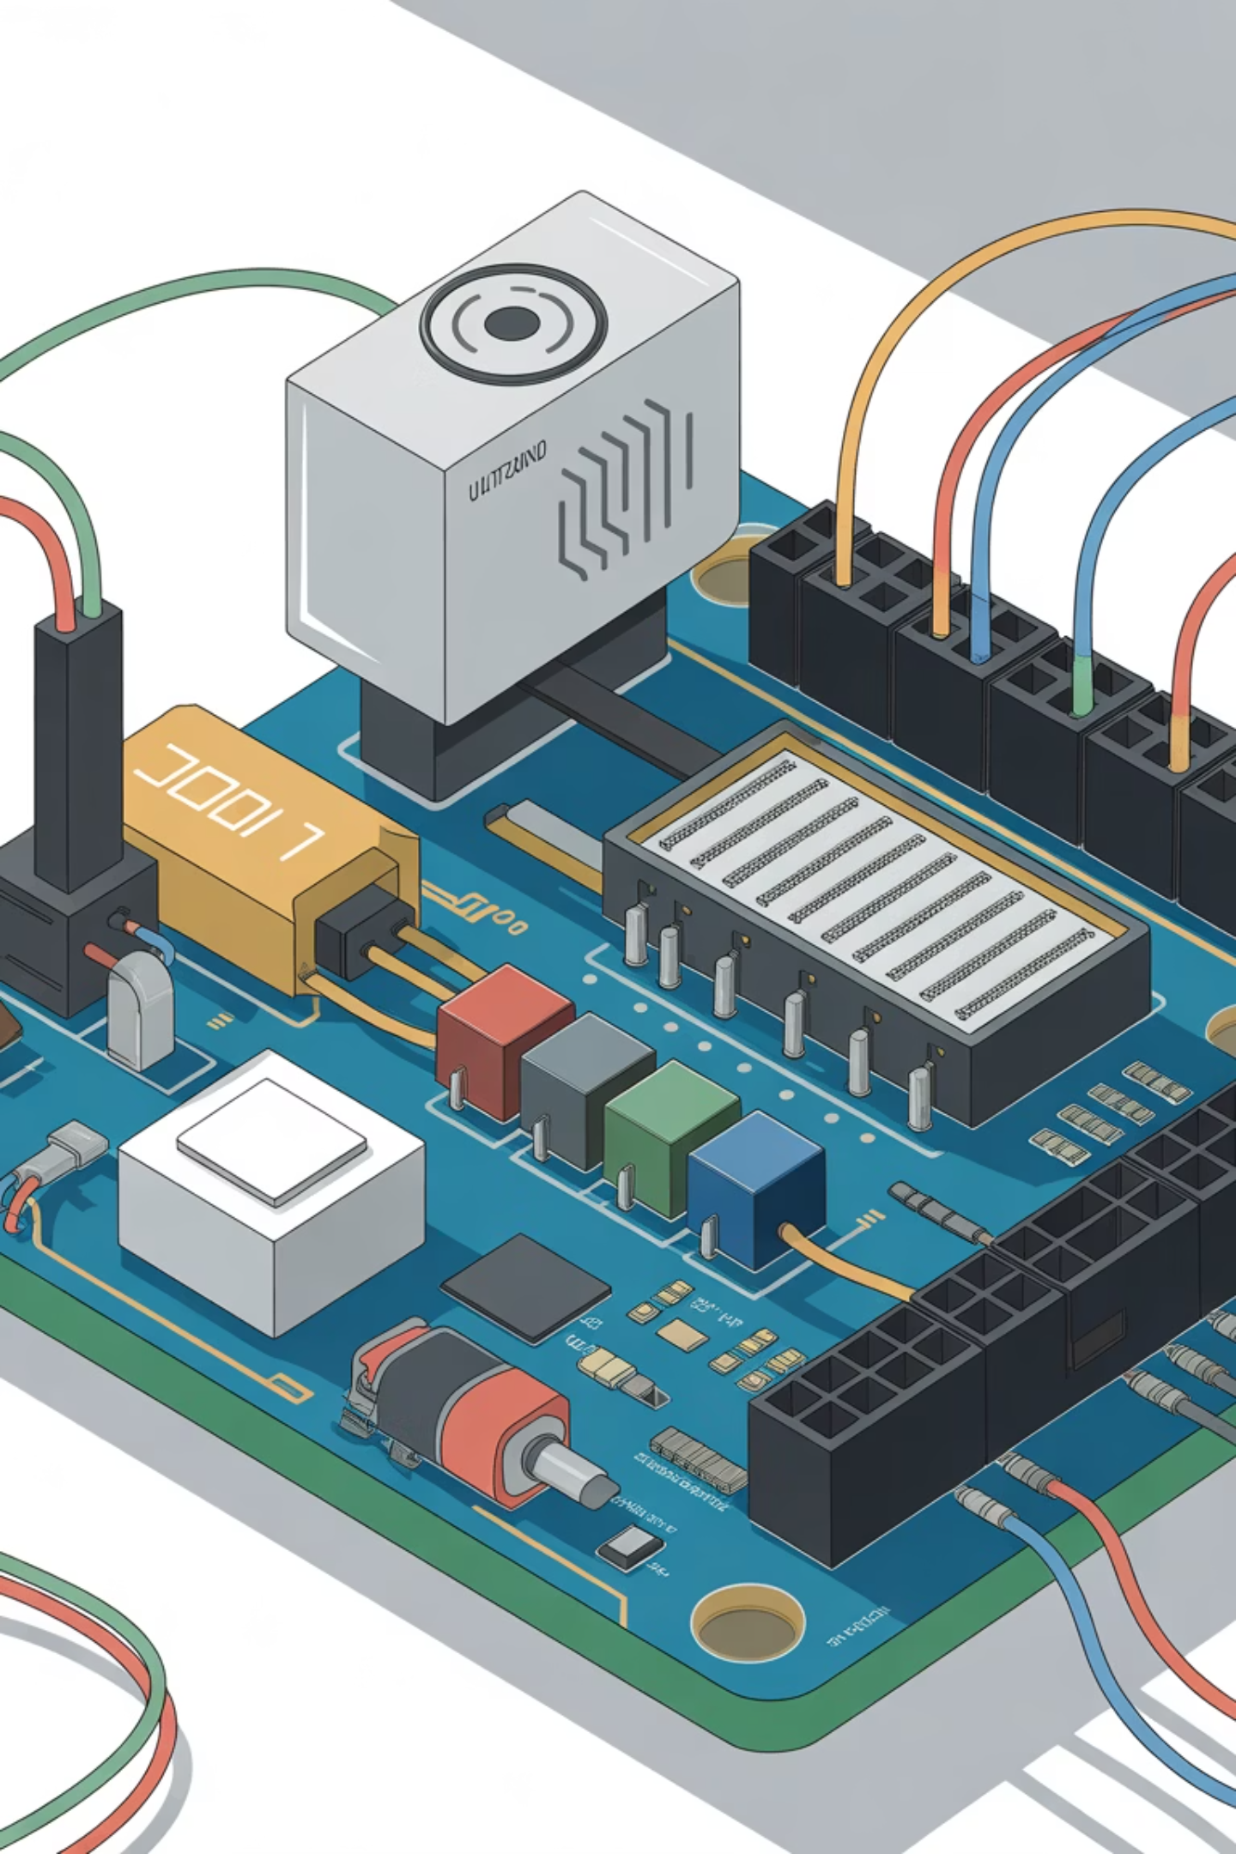
Phase 3 - Components
What You Need:
HC-SR04 Ultrasonic Sensor
4-Digit 7-Segment Display
74HC595 Shift Register (may be built into display)
Complex Wiring: This is the most involved - take your time!
LED, Buzzer, Button (from Phase 2 - keep connected!)
Multiple jumper wires

Slide 21
Phase 3 - Critical Connections
Shift Register & Display:
Pin 4 → Data
Pin 5 → Latch
Pin 6 → Clock
Pins 9-12 → Display common cathodes
Keep Phase 2 components: Pin 7 (buzzer), Pin 8 (button), Pin 13 (LED)
Ultrasonic Sensor:
Pin 2 → TRIG
Pin 3 → ECHO
VCC → 5V rail
GND → Ground rail

Slide 22
Phase 3 - Let's Build
Steps:
01
02
03
Add 4-digit display with shift register connections
Add ultrasonic sensor (TRIG to Pin 2, ECHO to Pin 3)
Verify all Phase 2 components still connected
04
05
Copy Phase 3 code from GitHub
Upload and test!
Testing:
Move your hand toward/away from sensor
Display shows distance in cm
LED lights at ≤5cm
Buzzer beeps at ≤10cm (faster = closer)
Button mutes/unmutes buzzer

Slide 23

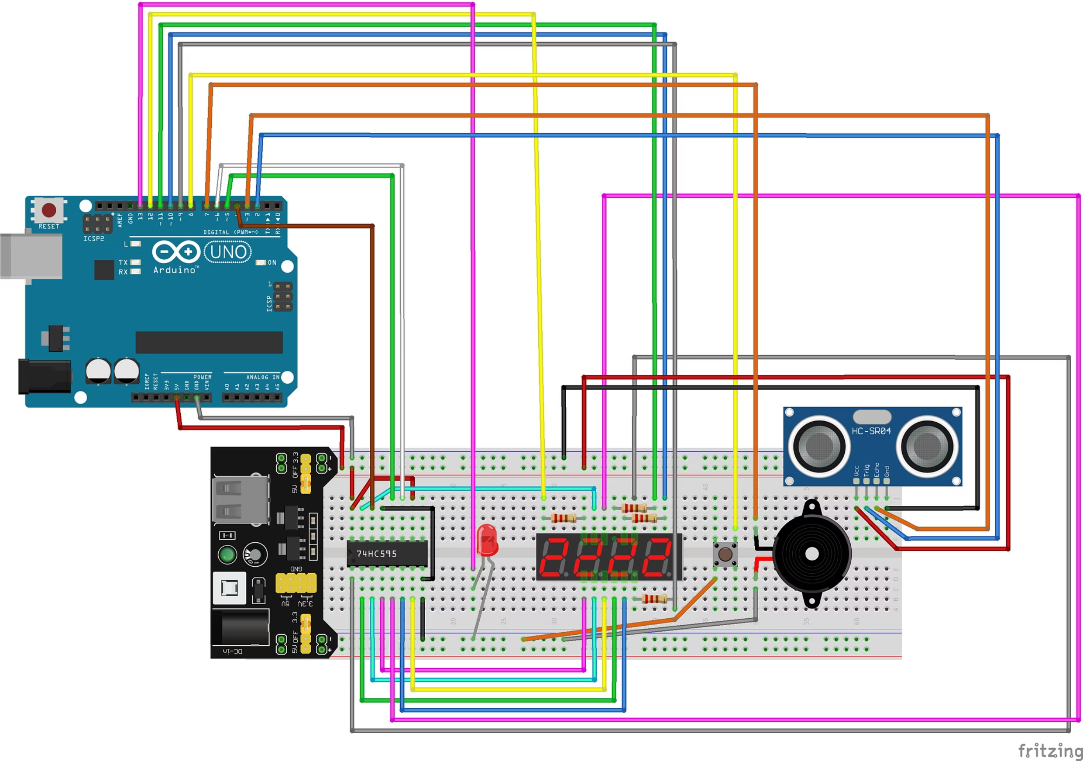

Slide 24
Quick Check
Phase 3 Status Check:
👍 Working?
🤔 Still building?
❌ Having issues?
Experiment with different distances!
Keep going - this is the complex one!
Common problems in troubleshooting guide
Everyone's at different stages - that's completely normal!

Slide 25





What You Built Today
Four Progressive Systems:
Power verification - Foundation for everything
Simple output control - LED blinking (processor → output)
Interactive control - Button input with multiple outputs (input → processor → outputs)
Autonomous sensor system - Distance-based alarm with display (sensor → processor → multiple outputs)
The Evolution: From simple blink to complete IoT automation!

Slide 26


The Building Block Approach
Phase 1:
Phase 2:
Phase 3:
OUTPUT only (LED)
INPUT + OUTPUTS (button → LED + buzzer)
SENSOR + PROCESSING + MULTIPLE OUTPUTS (ultrasonic → Arduino logic → display + LED + buzzer)
This is how ALL IoT systems work
- just different combinations of these same building blocks!

Slide 27
The Flexibility of Arduino
Same Arduino, Endless Possibilities:
Home automation systems
Weather stations
Your kit has even more: Temperature sensors, servo motors, LCD display, IR receiver, relay...
Robots and drones
Art installations
Wearable tech
Industrial monitoring

Slide 28
Resources & Next Steps
GitHub Repository:
Keep Learning:
https://tinyurl.com/5fan5erw
Arduino official tutorials (arduino.cc)
All Phase 0-3 code
Online communities (Arduino forums, Reddit r/arduino)
Wiring diagrams for each phase
Experiment with other components in your kit!
Component specifications
Detailed troubleshooting guide

Slide 29

Q&A / Troubleshooting
Questions?
About what we built today
Component functionality
Where to go next
Troubleshooting your Phase 3 build
Still working on Phase 3? Keep building - we're here to help!

Slide 30
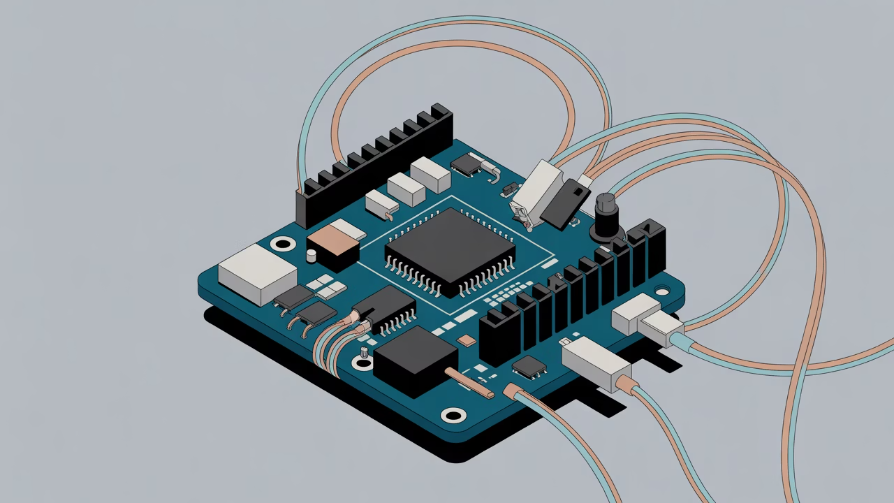
Wire We Doing This?
Thanks for building IoT systems with us today!
Resources: https://tinyurl.com/5fan5erw
Questions: jowen@ftsc.com apatel@ftsc.com
Happy tinkering! 🔧⚡

